Slide 1
Technical Training in
JAVA
Naga Sriharsha Mulugu
Asst. Prof.
Dept. of CSE
nagasriharsha@vvit.net
24-08-2020

Slide 2
PROBLEM STATEMENT
Aman and Jasbir are very intelligent guys of their batch. Today they are playing a game "Game of Numbers".
Description of game:
There are N numbers placed on a table. Since two players are playing the game, they will make their moves alternatively. In one move a player can perform the following operation.
A player will choose a number from the table and will replace that number with one of its divisor. For example, 6 can be replaced with 1, 2, or 3 (since these are the divisors of 6). Similarly, 12 can be replaced with 1, 2, 3, 4 or 6.
It is mandatory that the player has to replace the number.
A player cannot put back the same number on table.
As 1 does not have any divisor other than itself, a player cannot replace 1 with any other number. So soon a situation will arise when there will be only all 1s on the table. In that situation the player will not be able to make any move. The player who will not be able to make the move, loses.
Both the players are masters of this game. So they will play the game optimally.
Aman will make the first move of the game.
You will be given N integers that are on the table. You have to predict, who will win the game - Aman or Jasbir.

Slide 3
PROBLEM STATEMENT
Input Format:
First line contains information about the numbers present of the table, denoted by N
Second line contains N integers delimited by space - A1 A2 A3 A4 ......... AN
Output Format:
Print the name of the player who will win the game in upper case i.e. AMAN or JASBIR.
Constraints1 <= N <= 100000
0 < Ai <= 10000
A player cannot replace more than 1 number in one move.
Players move alternate and a player cannot pass or make no move.
A number cannot be replaced itself, i.e. 6 can be replaced with 1, 2 or 3 only , not with 6.
Aman always makes the first move.

Slide 4
TEST CASES
SAMPLE INPUT | SAMPLE OUTPUT
1 3 | AMAN
4 24 45 45 24 | JASBIR
6 24 45 45 24 30 35 | AMAN

Slide 5
PROBLEM STATEMENT
A Milkman serves milk in packaged bottles of varied sizes. The possible size of the bottles are {1, 5, 7 and 10} litres. He wants to supply desired quantity using as less bottles as possible irrespective of the size. Your objective is to help him find the minimum number of bottles required to supply the given demand of milk.
Input Format
First line contains number of test cases N
Next N lines, each contain a positive integer Li which corresponds to the demand of milk.
Output Format
For each input Li, print the minimum number of bottles required to fulfill the demand
Constraints
1 <= N <= 1000
Li > 0
1 <= i <= N

Slide 6
TEST CASES
SAMPLE INPUT | SAMPLE OUTPUT
2 30 9 | 3 3
2 65 32 | 7 4
2 17 65 | 2 7
2 99 63 | 11 8

Slide 7
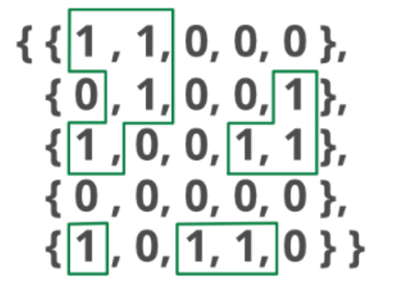
PROBLEM STATEMENT
Write a program to count islands in Boolean 2D matrix of size 5*5.
Note: A group of connected 1s form an island.
For example,
The above matrix contains 4 islands.
Input Format
To get the matrix from user.
Output Format
Displays the number of islands.
Constraints
Binary numbers only.

Slide 8
TEST CASES
SAMPLE INPUT | SAMPLE OUTPUT
1 0 0 0 1 1 1 0 0 0 0 0 0 1 1 1 0 1 0 0 0 0 0 0 0 | 4
1 0 0 0 1 1 1 1 1 1 0 0 0 1 1 1 0 1 0 0 0 1 1 1 0 | 1
1 1 1 0 1 1 1 0 0 1 0 0 0 1 1 1 0 1 0 1 0 0 0 0 1 | 3

Slide 9

“Nothing will work unless you do”
--Maya Angelou

